Slide 1

Cybersecurity For Bank remote workers through Application
Project manager: Hasan Alhwietat

Slide 2
Main idea the project: -
We will create an app that provides security for remote employees. This application will contain anti-virus software and provide a connection with the company via VPN in order to protect the devices with an encrypted connection with the company and the employees will backup the data and transfer the important data to the data center. It also sends alert messages to specialists in the event that security vulnerabilities are found those cause problems for the organization in order to find a solution to this gap.

Slide 3

Objective of the project: -
Protecting the company from risks and increasing security.
Increase employees productivity.
Reducing the waste of working hours due to the security risks that may occur.
Employees and client data protection.

Slide 4
Scope of the project: -
The application will solve all the problems that occurred during remote work for the bank company, it will provide security for the devices and will All employees download it to their devices. When you download this software, it asks for username and password for employee verification. When the software is run, it is ensured that the device has anti-virus software, if not, it will be downloaded automatically in order to ensure the protection of the devices and it will provide the employees with an encrypted connection in order to ensure data protection when moving from the devices to the data center such as a virtual private network (VPN) It also sends alert messages to specialists if security holes are discovered that cause problems for the organization in order to find a solution to this gap. Employees will be asked to reset the password on an ongoing basis, thus protecting the organization and increasing employee productivity and business continuity without interruption and We will train all employees on this application.

Slide 5
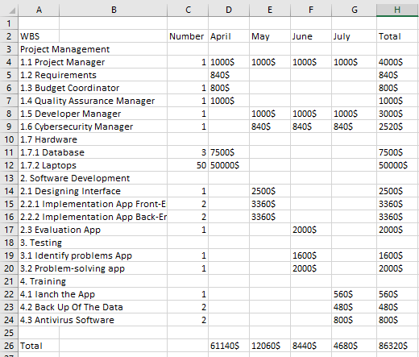
Cost of the project: -

Slide 6
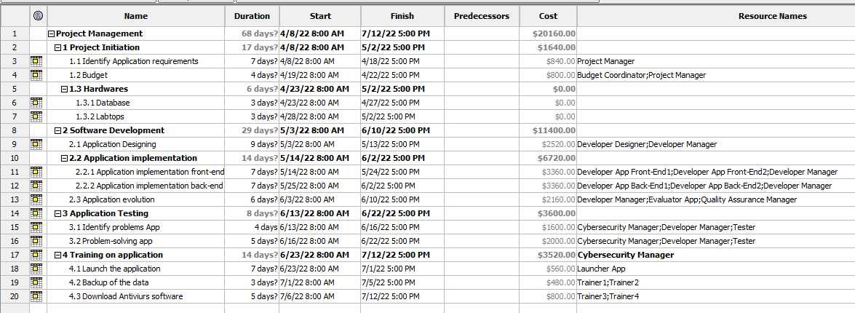
Gantt chart: -

Slide 7
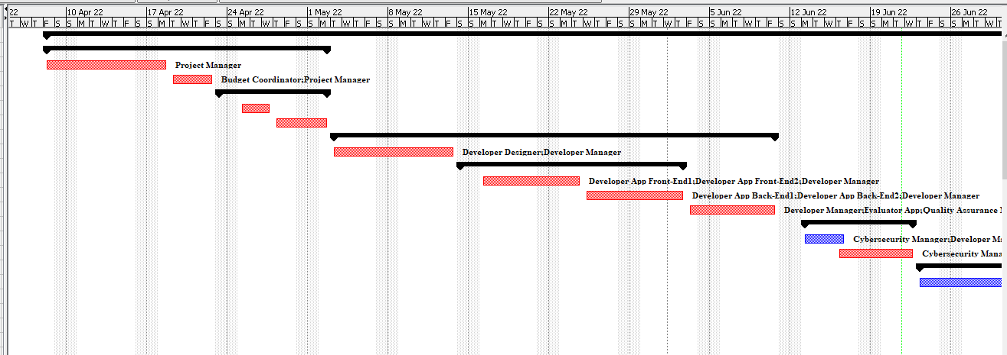
Gantt chart: -

Slide 8
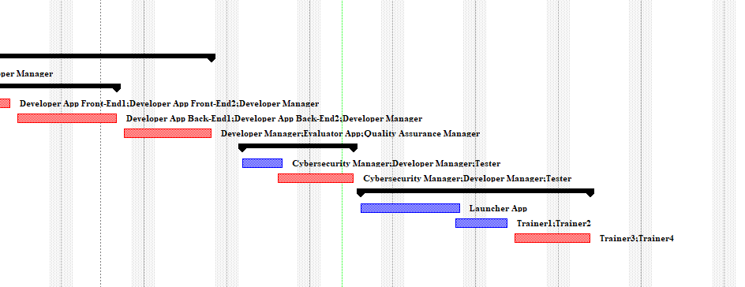
Gantt chart: -

Slide 9
Recommendations:-
Continuously developing and updating the application to provide security and prevent intrusions.
Setting a firewall device to monitor network traffic, prevent intrusion and hacking, and provide a barrier between the internal and external network, which provides protection for devices.
Establishing Network monitoring systems in order to detect and monitor network faults to ensure optimal performance and high efficiency.
Installing CCTV cameras in the data storage room to protect the devices.
Delete Duplicate Data on database.
Define file access permissions.

Slide 10

Thank you!
Any questions?

